Slide 1


Slide 2
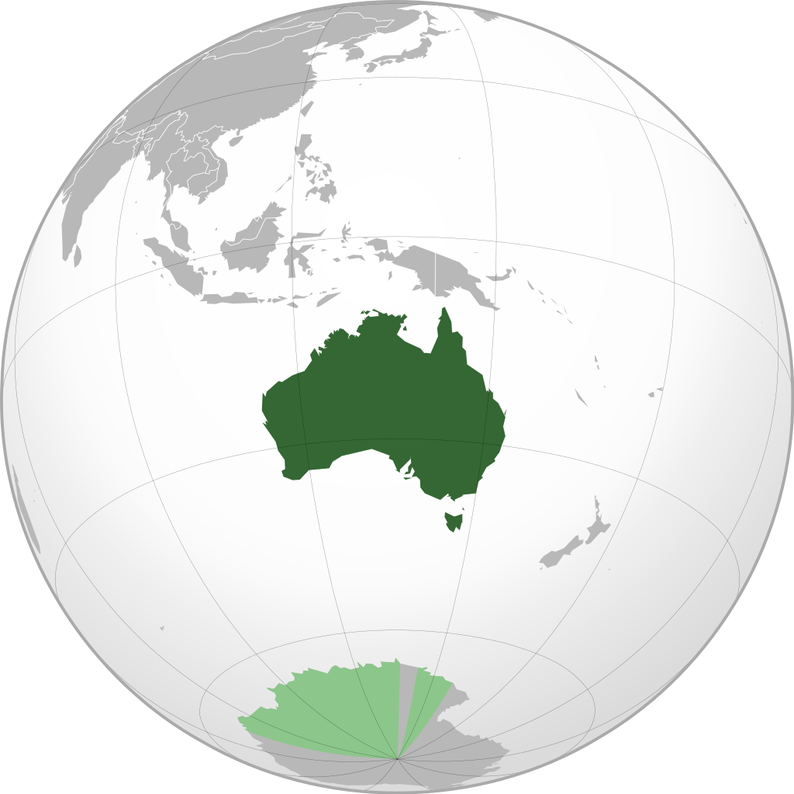
Notes:
Australia is known for its great variety of unique wild life

Slide 3
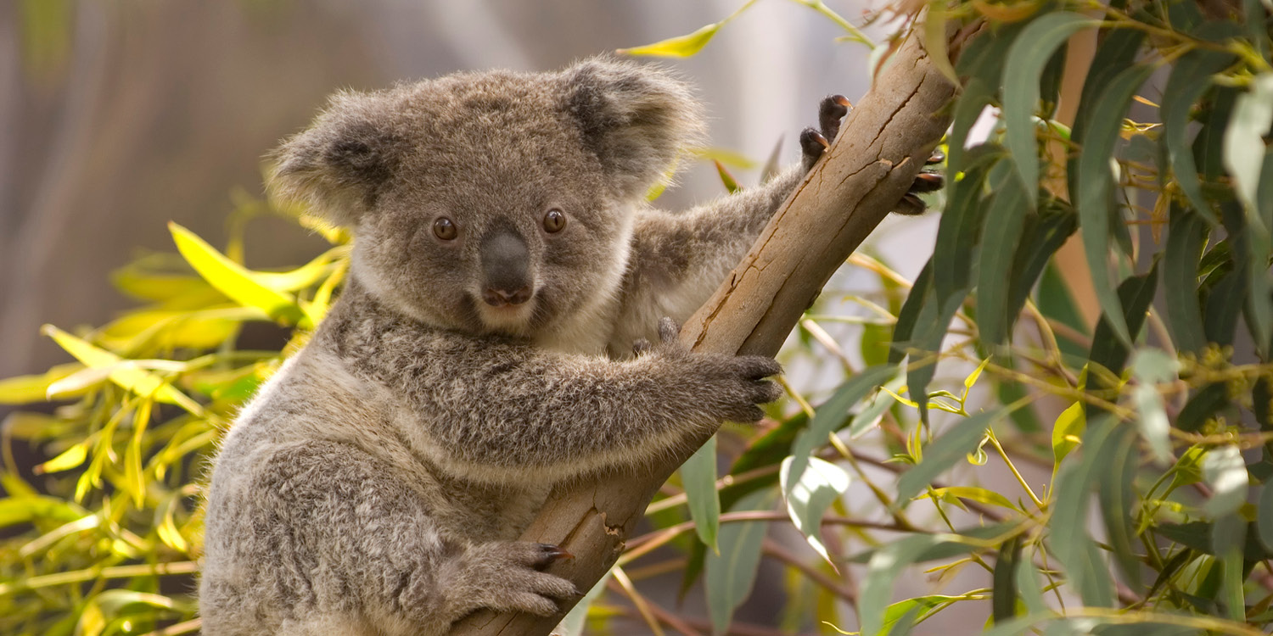
Notes:
It’s been estimated that at least 93 percent of its species of reptiles, amphibians, flowering plants and conifers are unique to Australia.

Slide 4
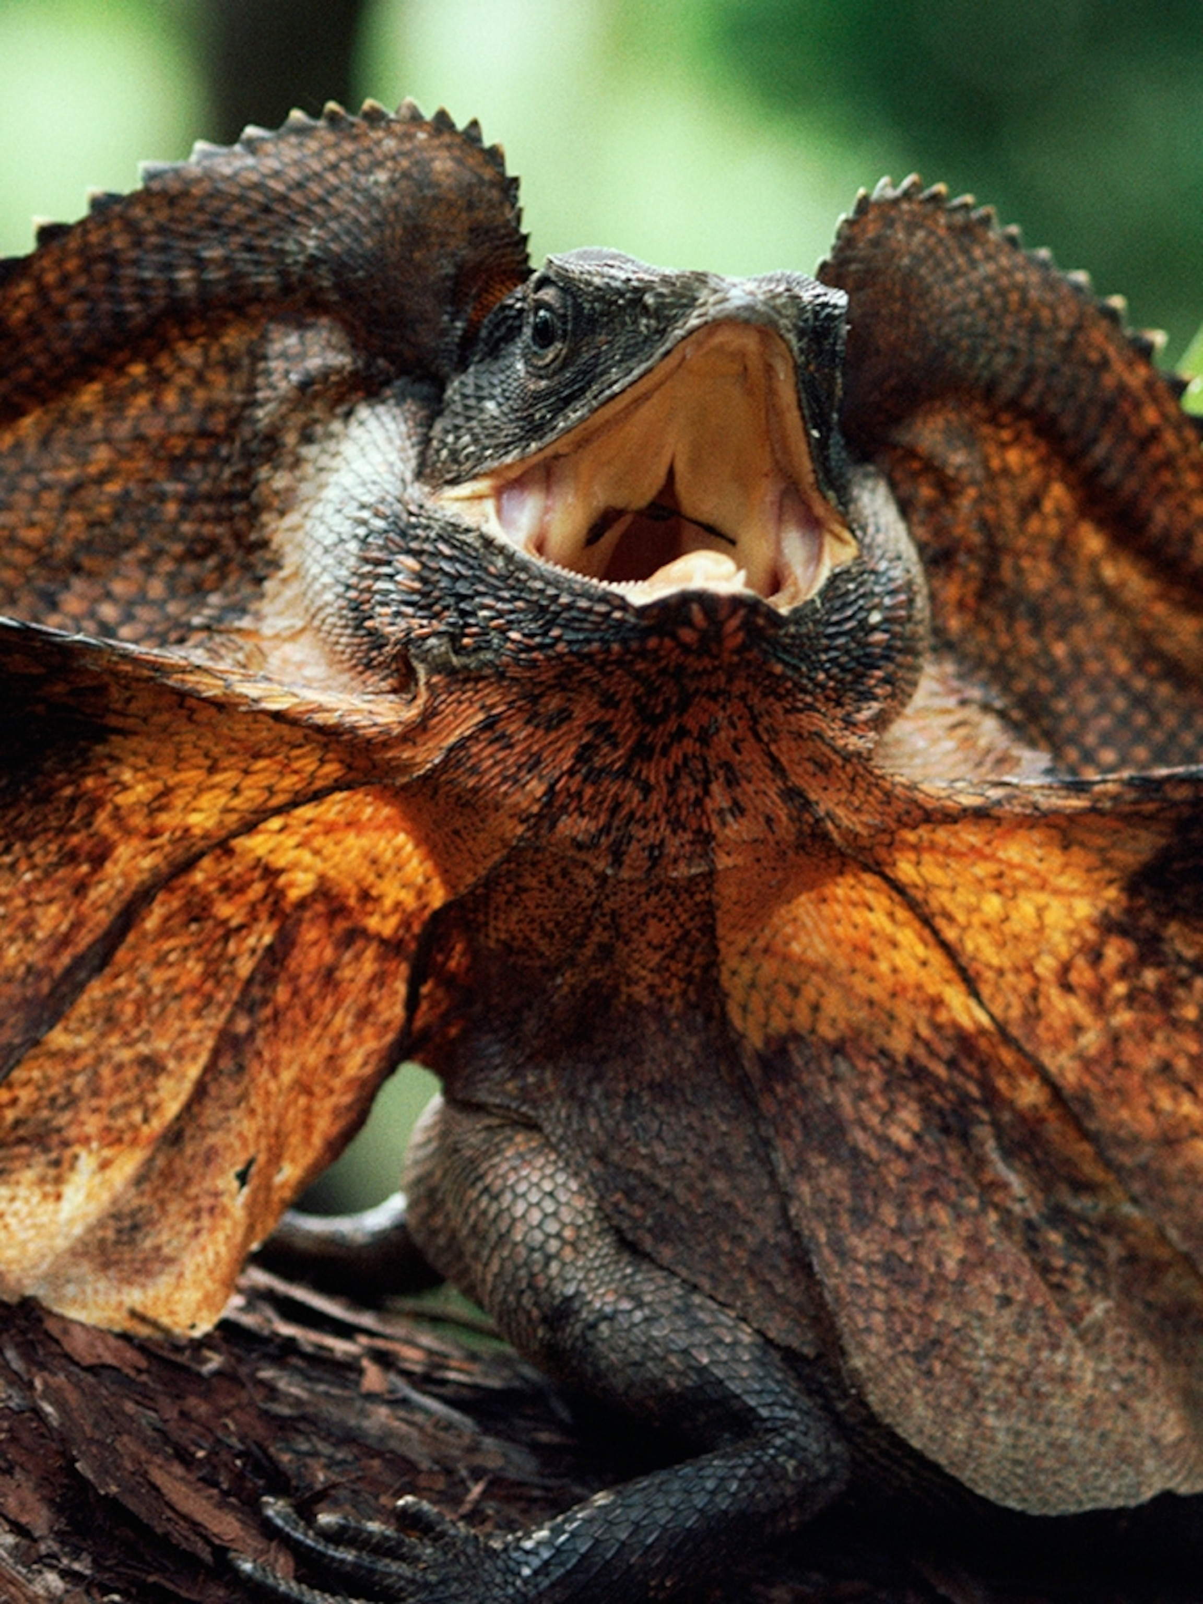

Slide 5


Slide 6
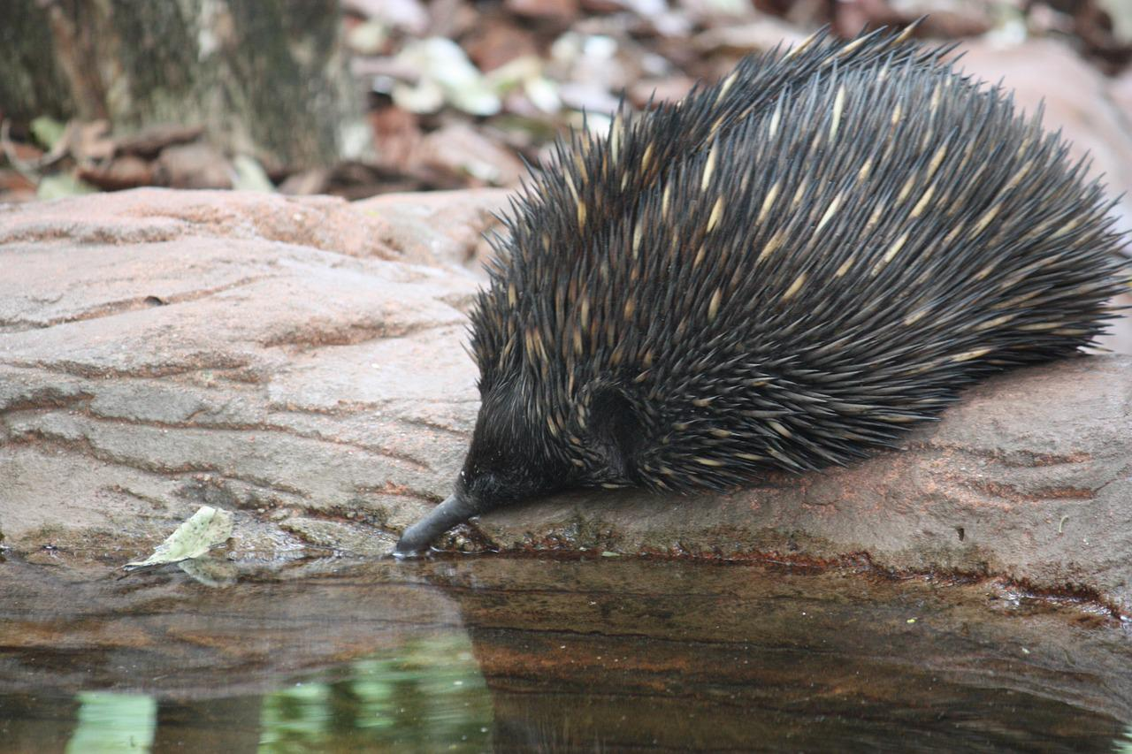

Slide 7
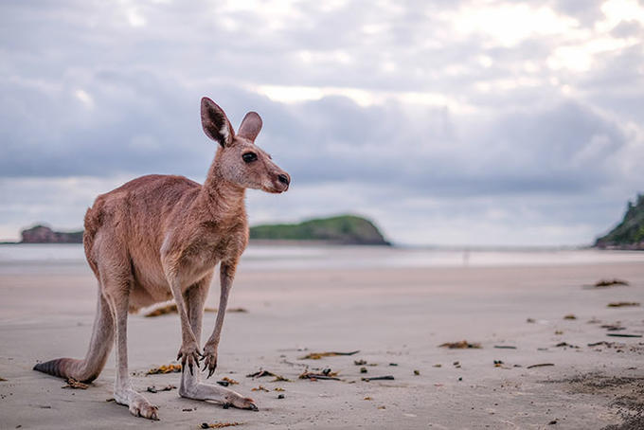

Slide 8
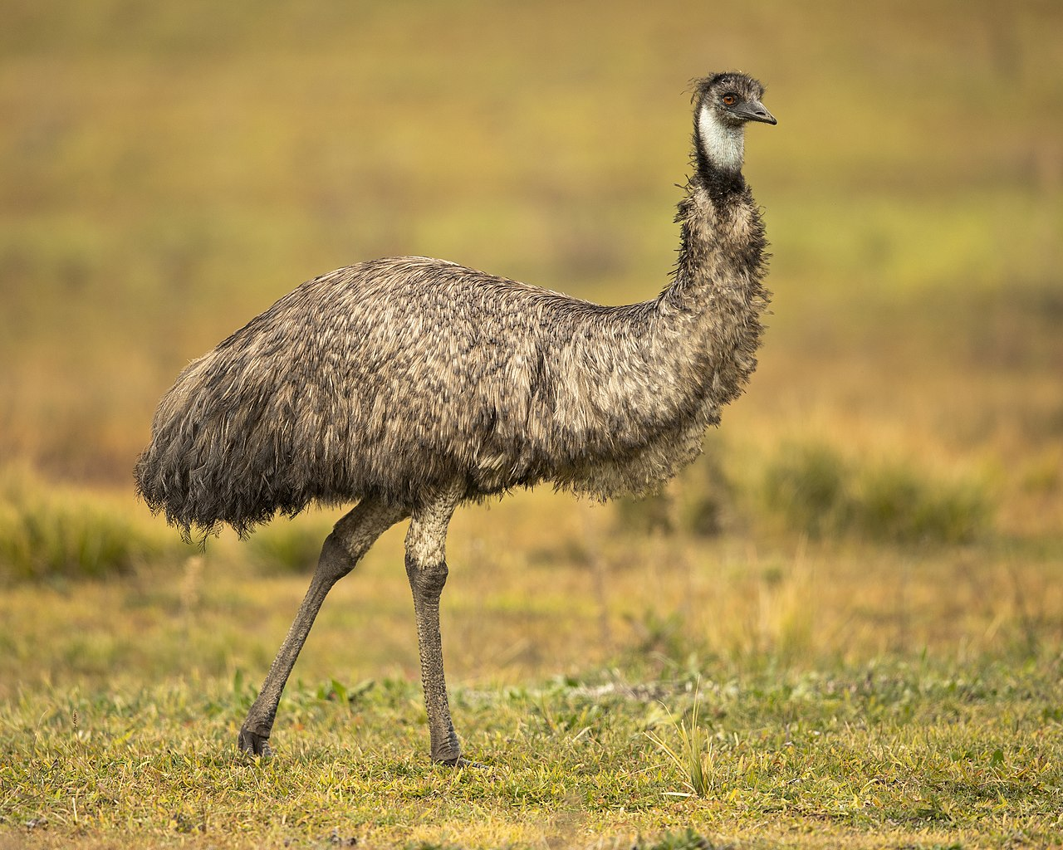

Slide 9
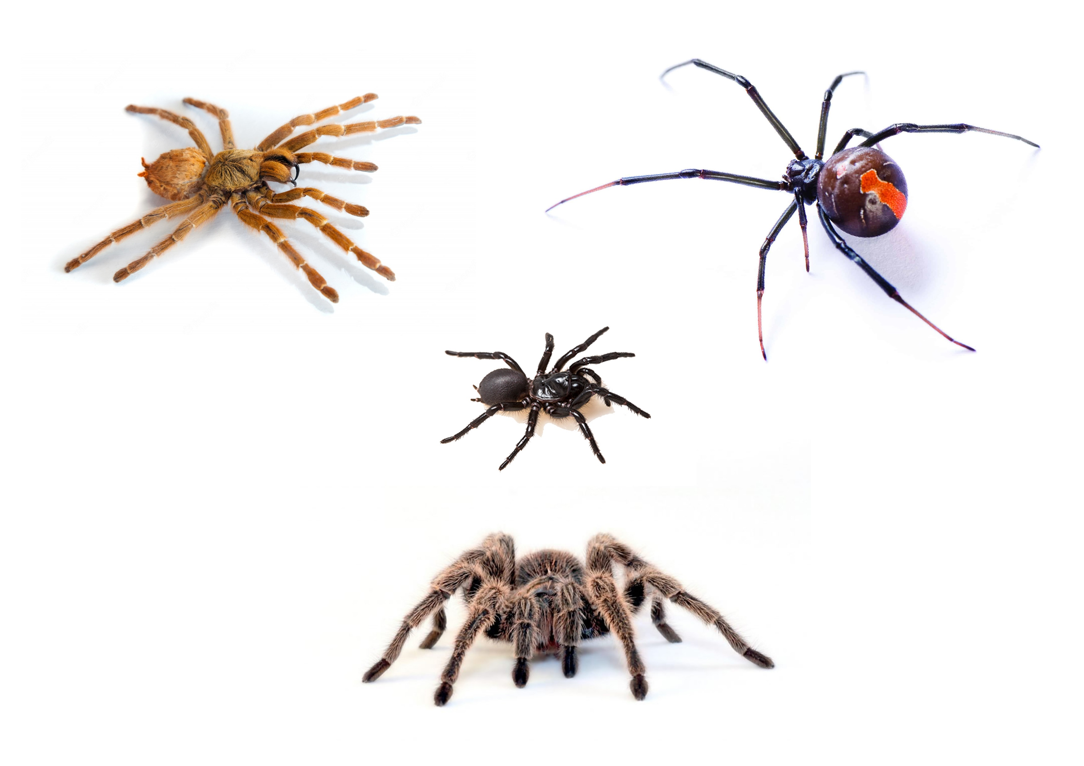
Notes:
Which is not necessarily a bad thing

Slide 10
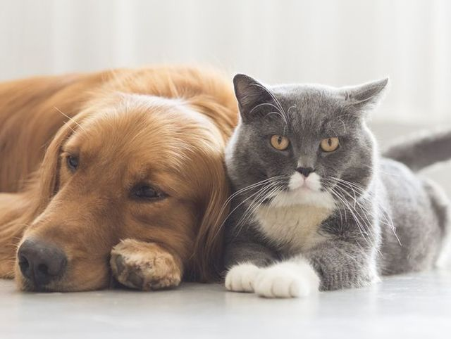
Notes:
Today we will concentrate on something that they share with the rest of the world: Cats and dogs

Slide 11
Notes:
In particular the work that the RSPCA or (Royal Society for the Prevention of Cruelty to Animals does for them

Slide 12
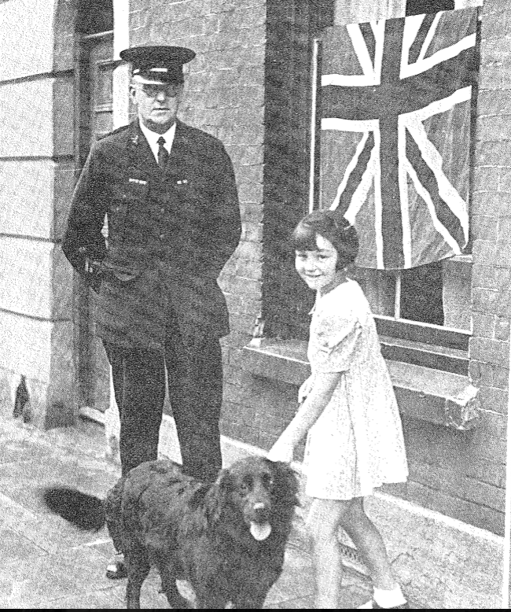
Notes:
RSPCA is an Australian organisation established in 1981 to promote animal welfare. Although its roots go back to 1871 when the Society for the Prevention of Cruelty to Animals (SPCA) was formed in the colony of Victoria on the model of the English SPCA.
RSPCA Australia defines its purpose as being the leading authority in animal care and protection, and to prevent cruelty to animals by actively promoting their care and protection.
With their mission for animal welfare in mind, this analysis will focus the numbers and type of animal complains RSPCA dealt over the last decade and their outcome. The aim is to point any KPI over time in a suburb, urban and national scale, so to identify focal point of interest for the organisation.

Slide 13
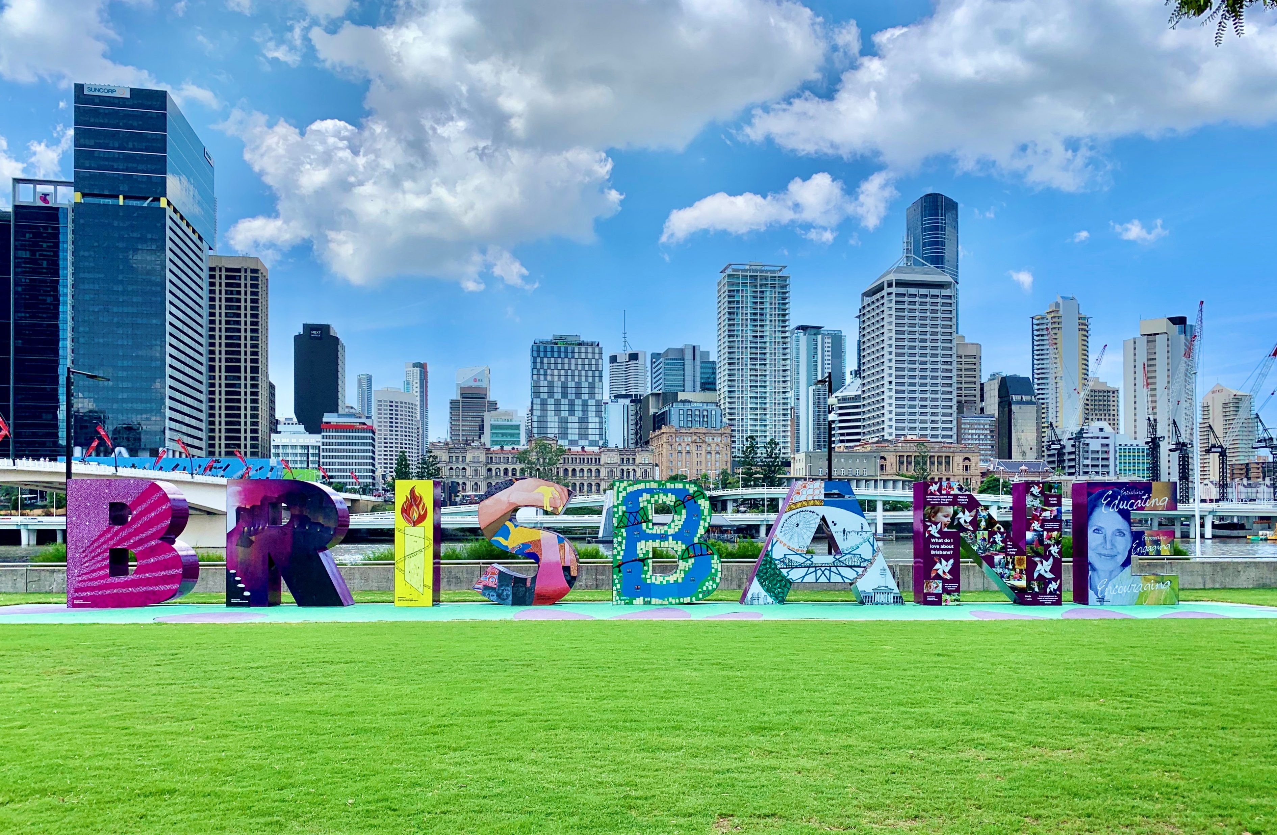
Notes:
We are going to analyse the type and amount of complaints RSPCA received in the town of Brisbane and Townville.

Slide 14
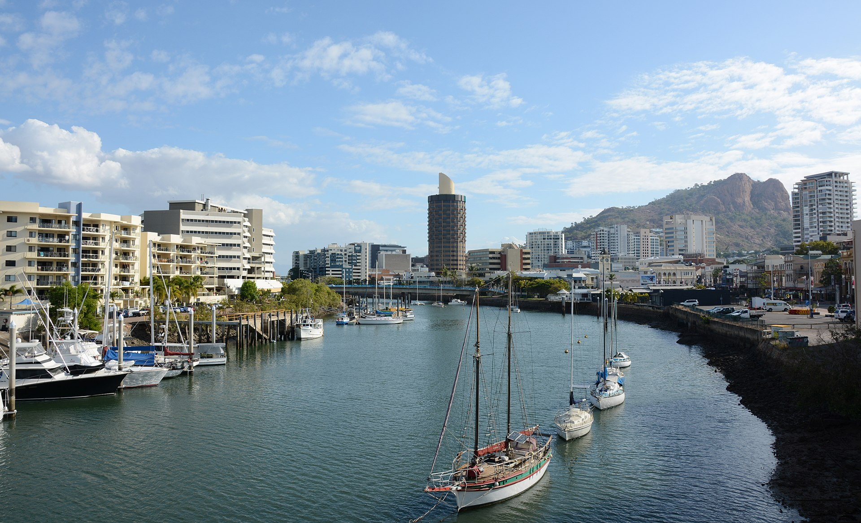
Notes:
Brisbane is the largest city in Australia and the third by population.
Townsville has a population of 180,820 and it is the largest settlement in North Queensland.

Slide 15
• What is the total call volume for complaint calls regarding pets in Brisbane and Townsville?
• Is there a particular animal being called about the most?
• Do particular suburbs have different type of complaint calls?
• How have the different outcomes trended over time? Did RSPCA work have an impact?
• Using the insights found, can we predict how this might look for the upcoming year?
Notes:
This analysis will focus on five questions
After the first three, we will look into the outcome of the complaints but this time on a national scale

Slide 16

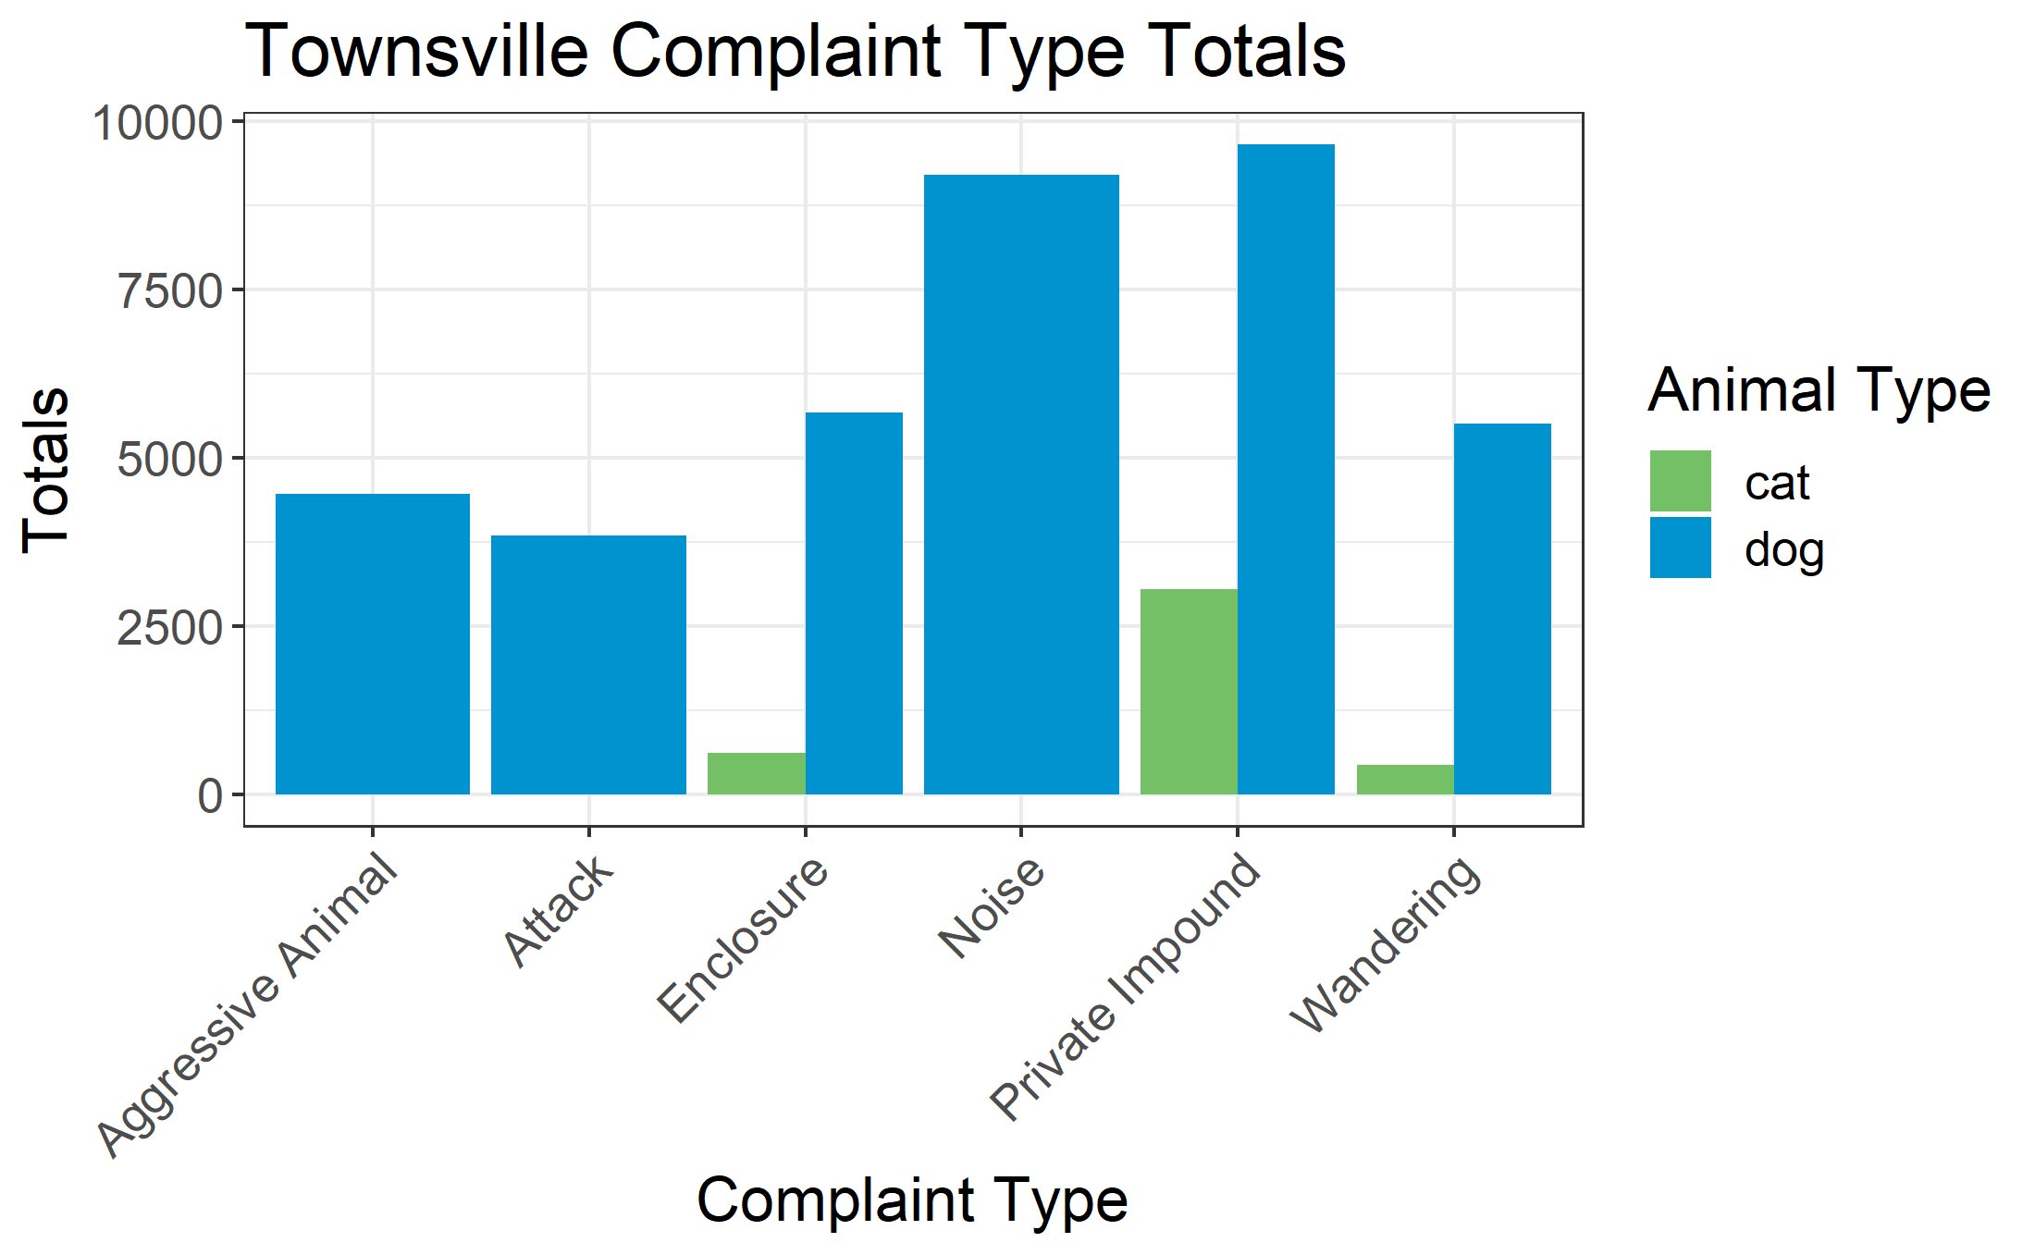
Notes:
In Townsville, dogs receive the more complaints.
Calls regarding Cats are more concentrated on the welfare of the animal rather than proper annoyance like in dogs

Slide 17

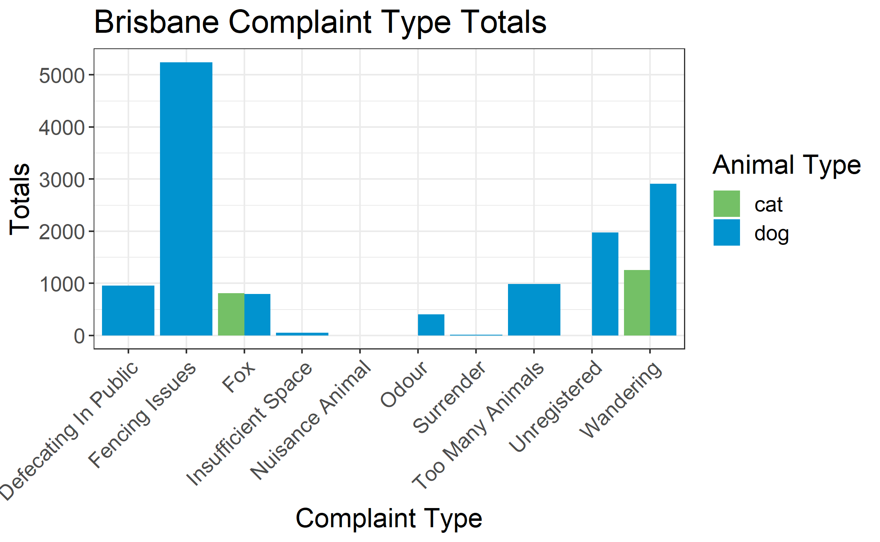
Notes:
In Brisbane again, dogs are again the focus of complains.
We can notice some difference from Townsville, there is more variety of complains and looks like in Brisbane dogs have something for fences.
Also, it seems to be an issue with foxes.
Let’s zoom in on this.

Slide 18
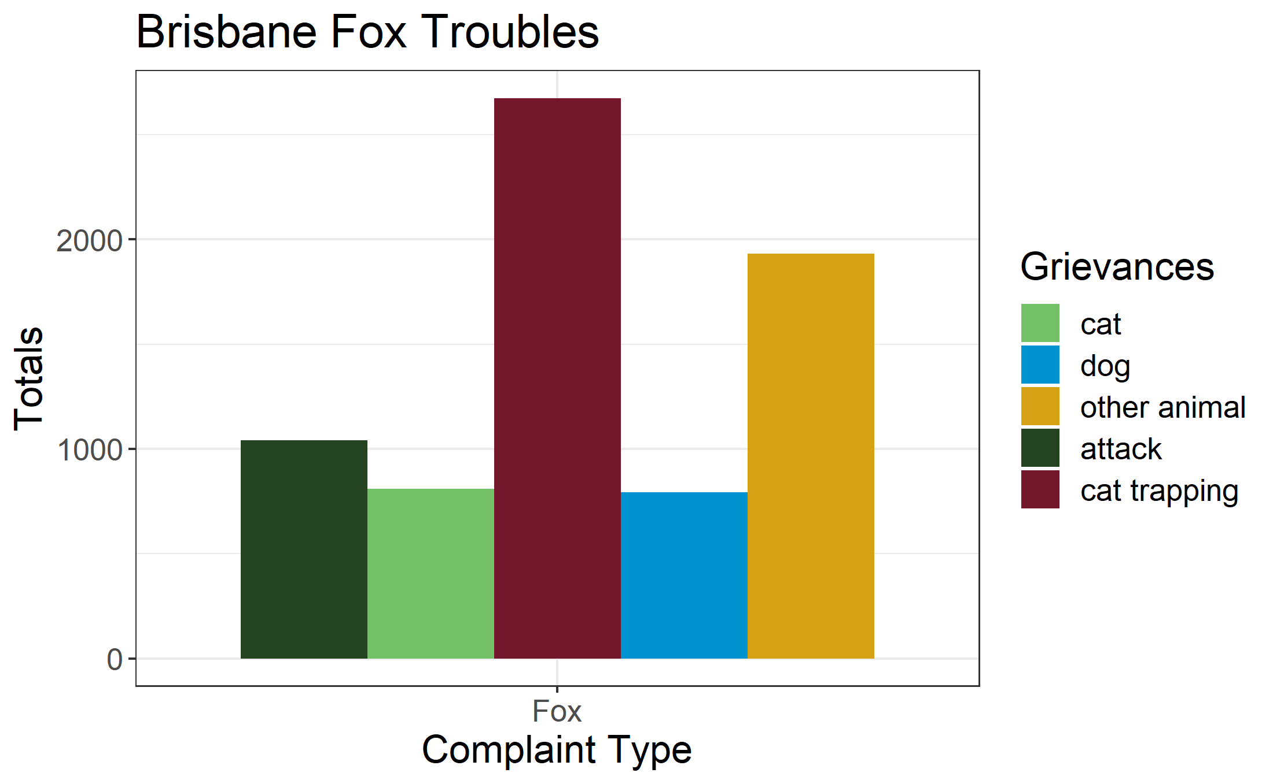
Notes:
A fair amount of complaints are regarding foxes attacking dogs and cats and in particular trapping the latter.
- Advise business to do campaign on keeping pets inside at home as long as it necessary.

Slide 19
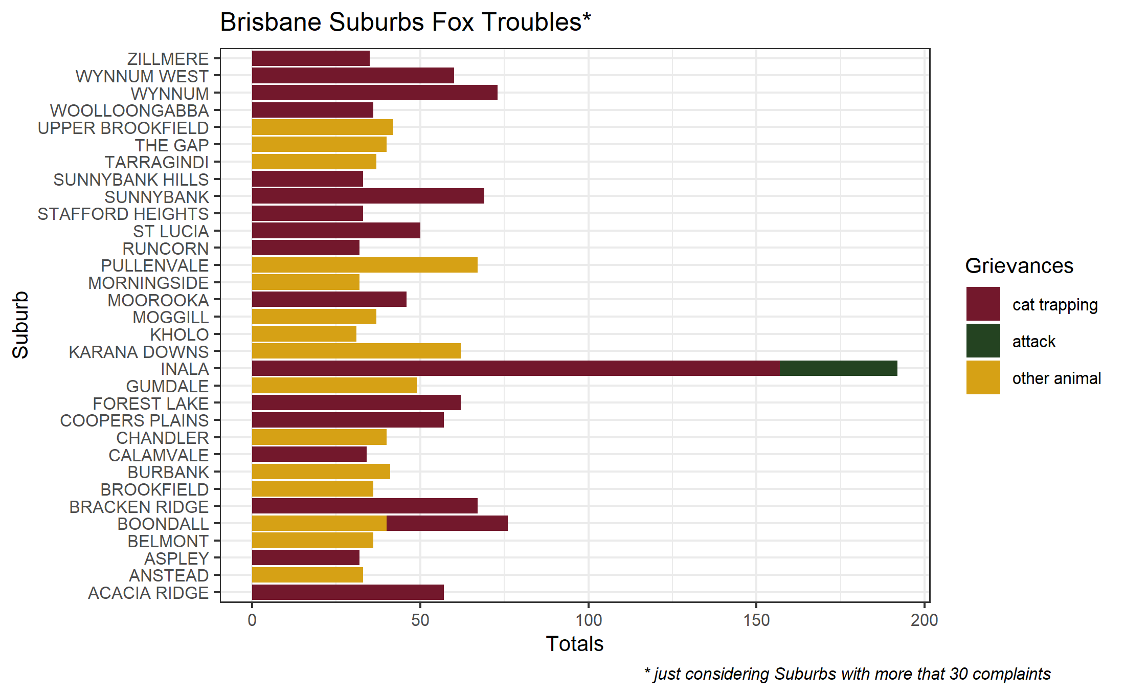
Notes:
If we look at the fox problem by suburb, we notice that the cat trapping issue is particularly felt in Inala.

Slide 20
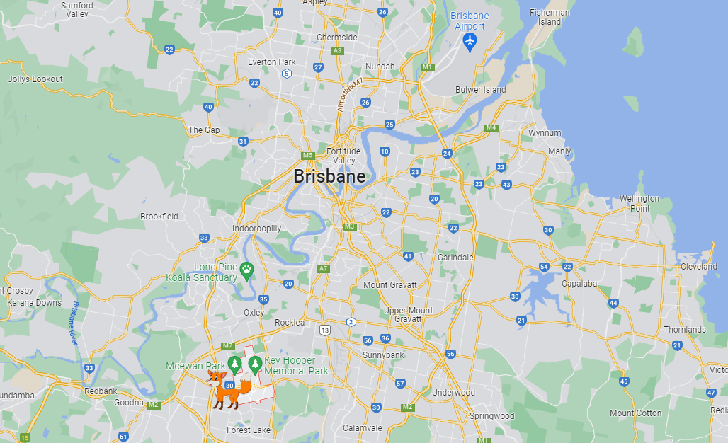
Notes:
An explanation could be the remote location of Inala. One of the more rural suburbs.

Slide 21
Notes:
Beside this, the other suburbs have to deal with foxes as well

Slide 22
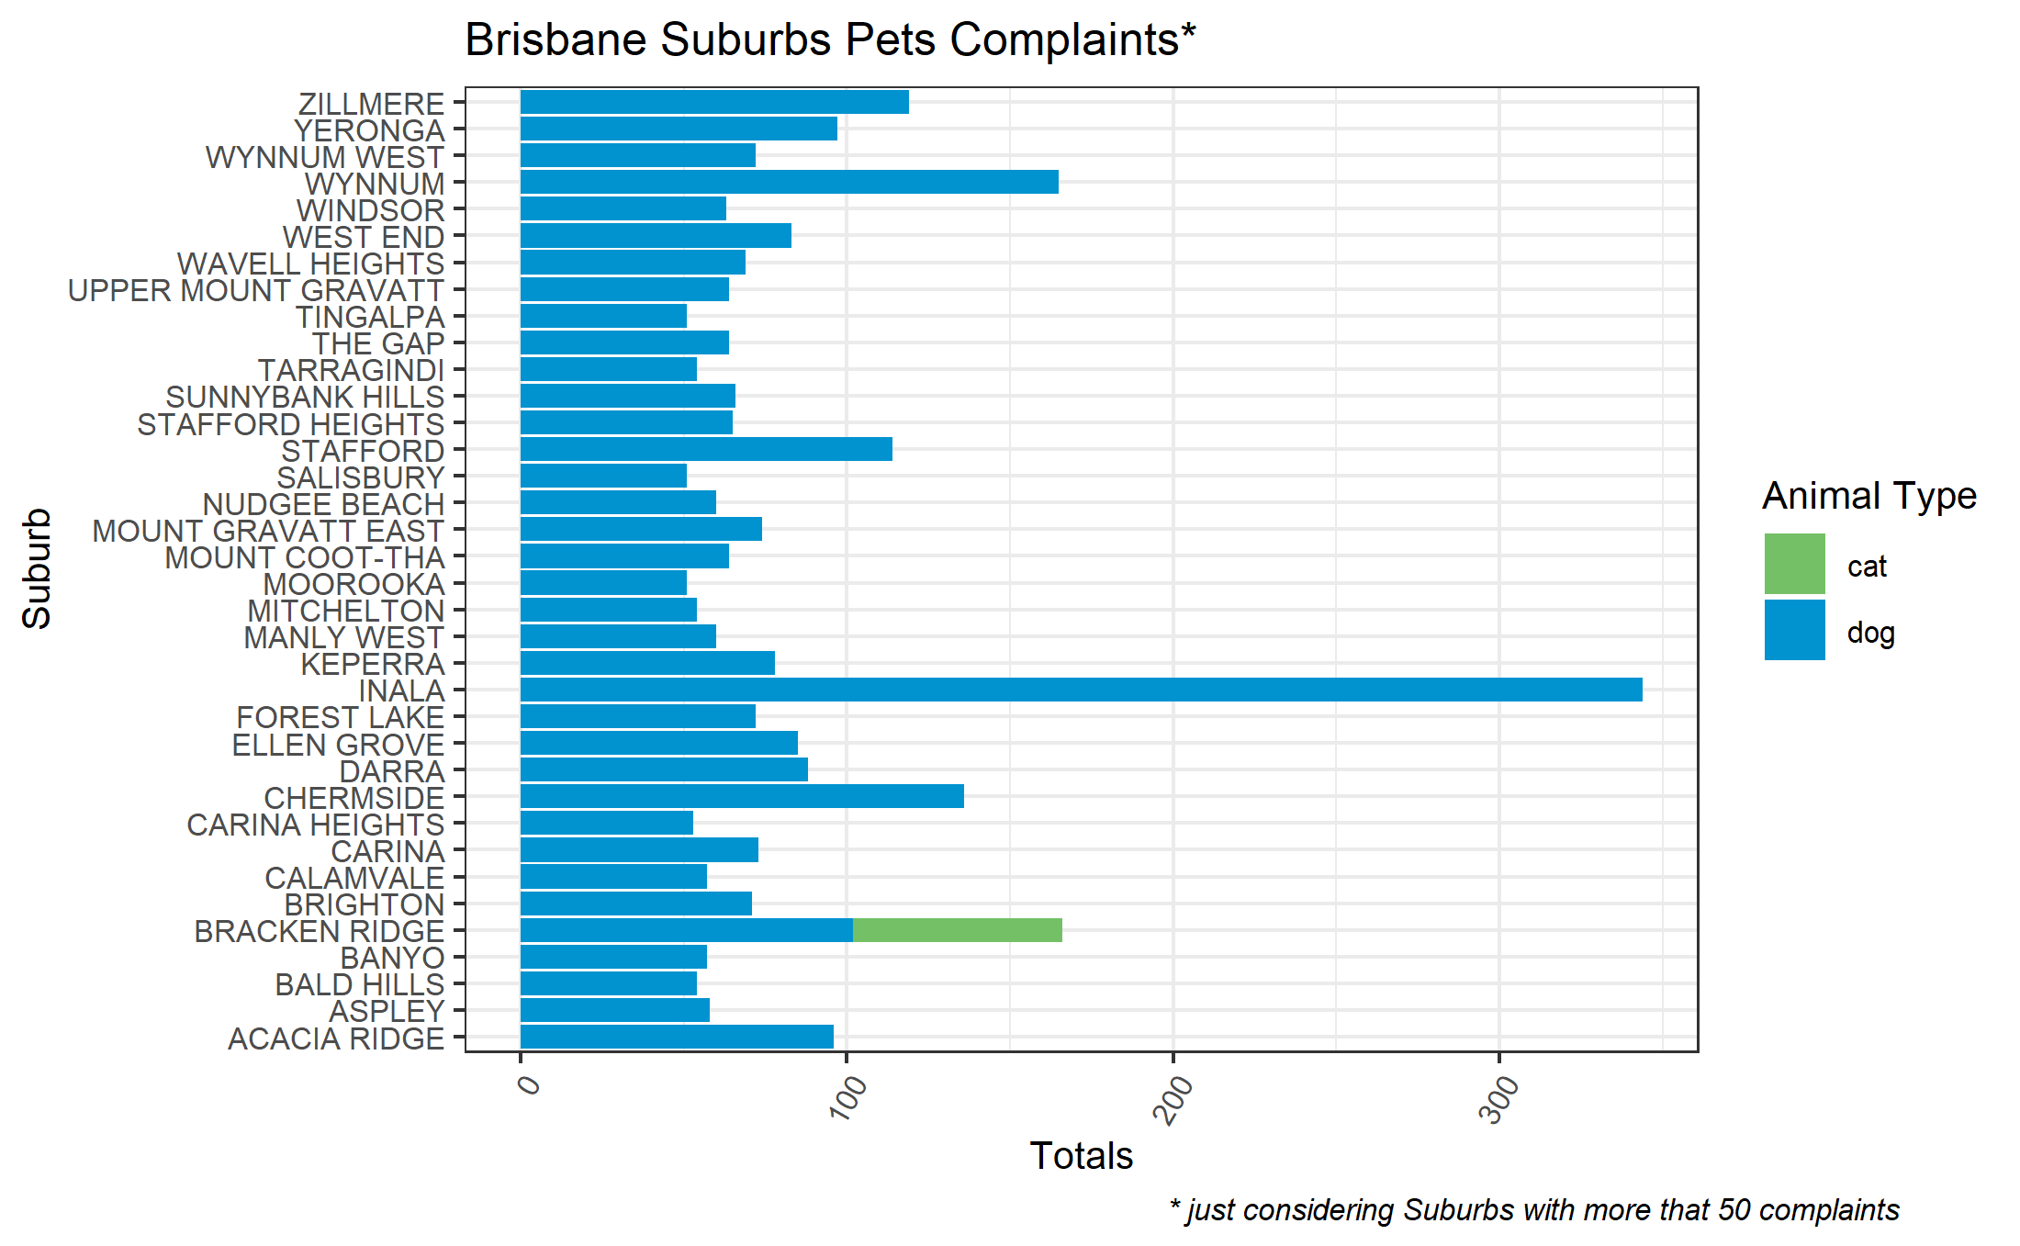
Notes:
Dogs are predominant in the complain in every suburbs. There are some calls in Bracken Bridge regarding cats and these seems again to be related to fox – GO BACK ONE SLIDE-

Slide 23
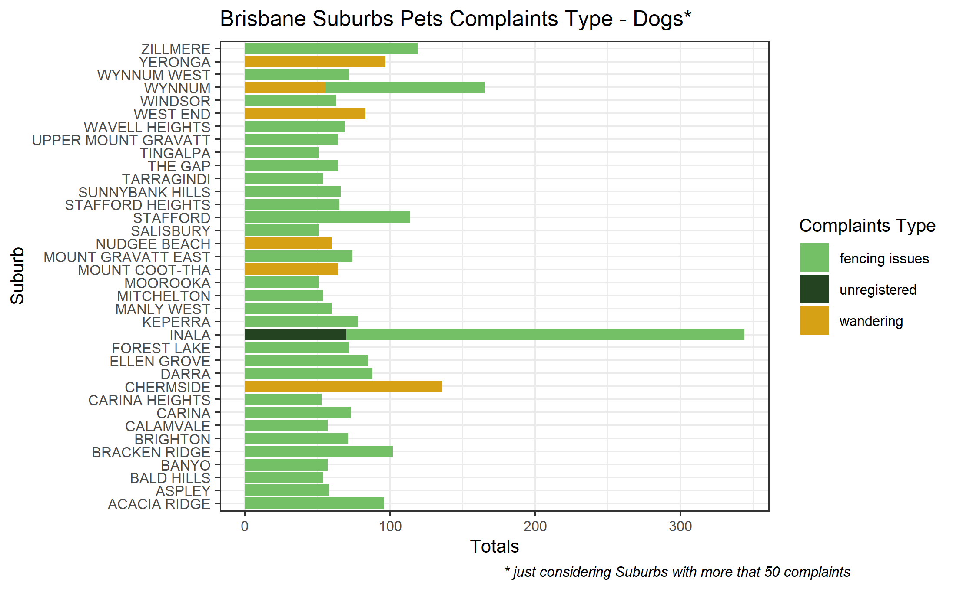
Notes:
The majority of the complaints are regarding fencing issues, so most probably problems between neighbors. Again, most of the calls are from Inala.

Slide 24
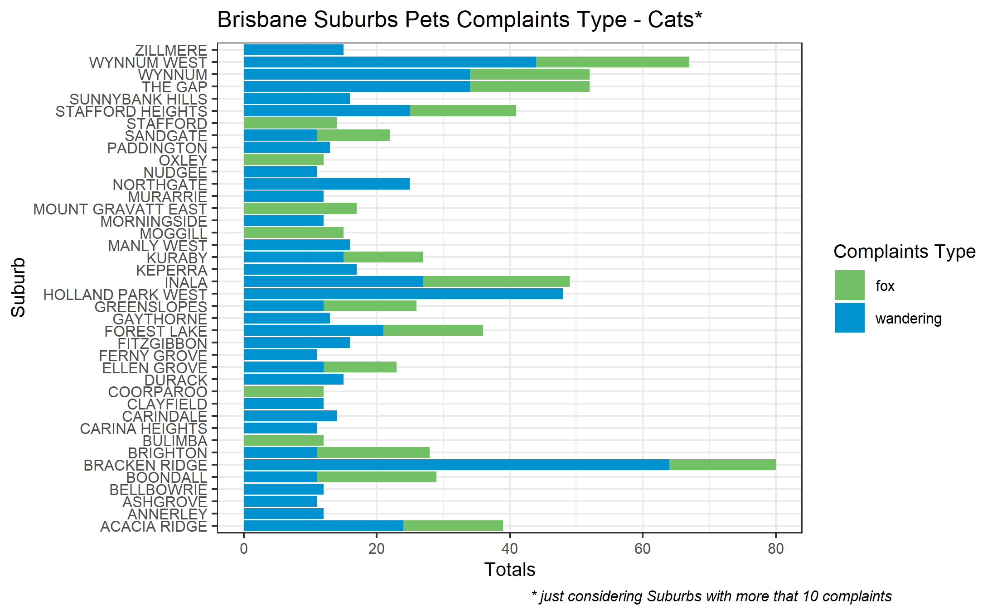
Notes:
While for cats we have the majority of calls are regarding a lost or stray cats wondering.
Plus the already mentioned, fox issue,

Slide 25
Notes:
Moving back to Townsville, these were the reasons for the majority of the complaints

Slide 26
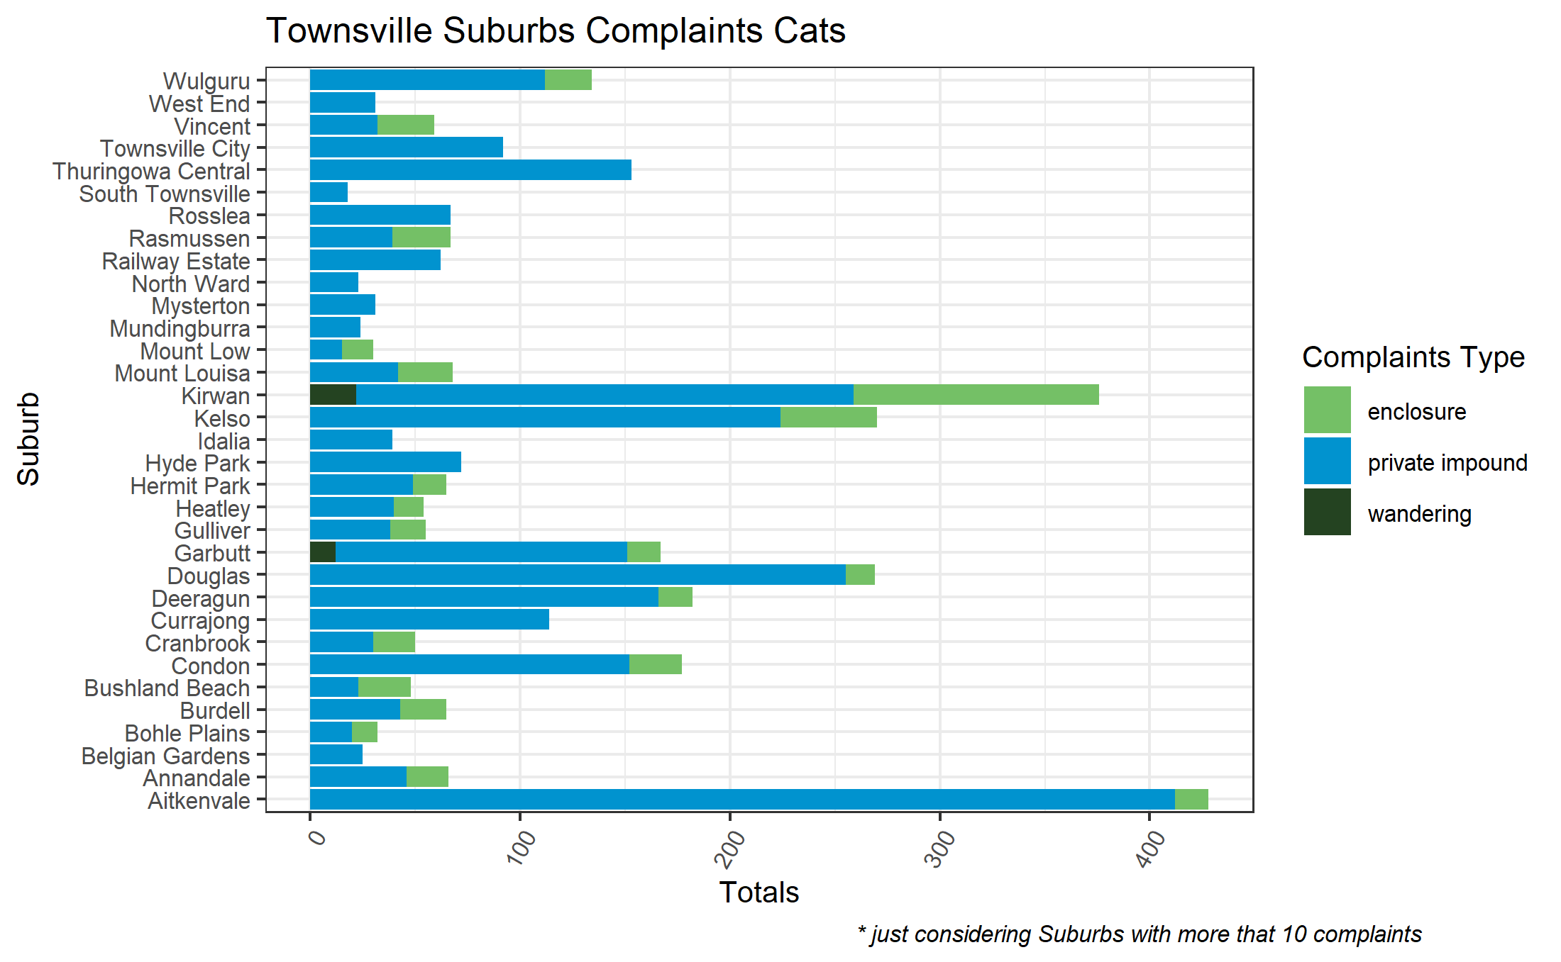
Notes:
If we look by suburbs, we see that the majority of calls for cat are for private impound which means that a person not associated with RSCA takes in a cat in this case and alert after that.
No foxes mentioned here.

Slide 27
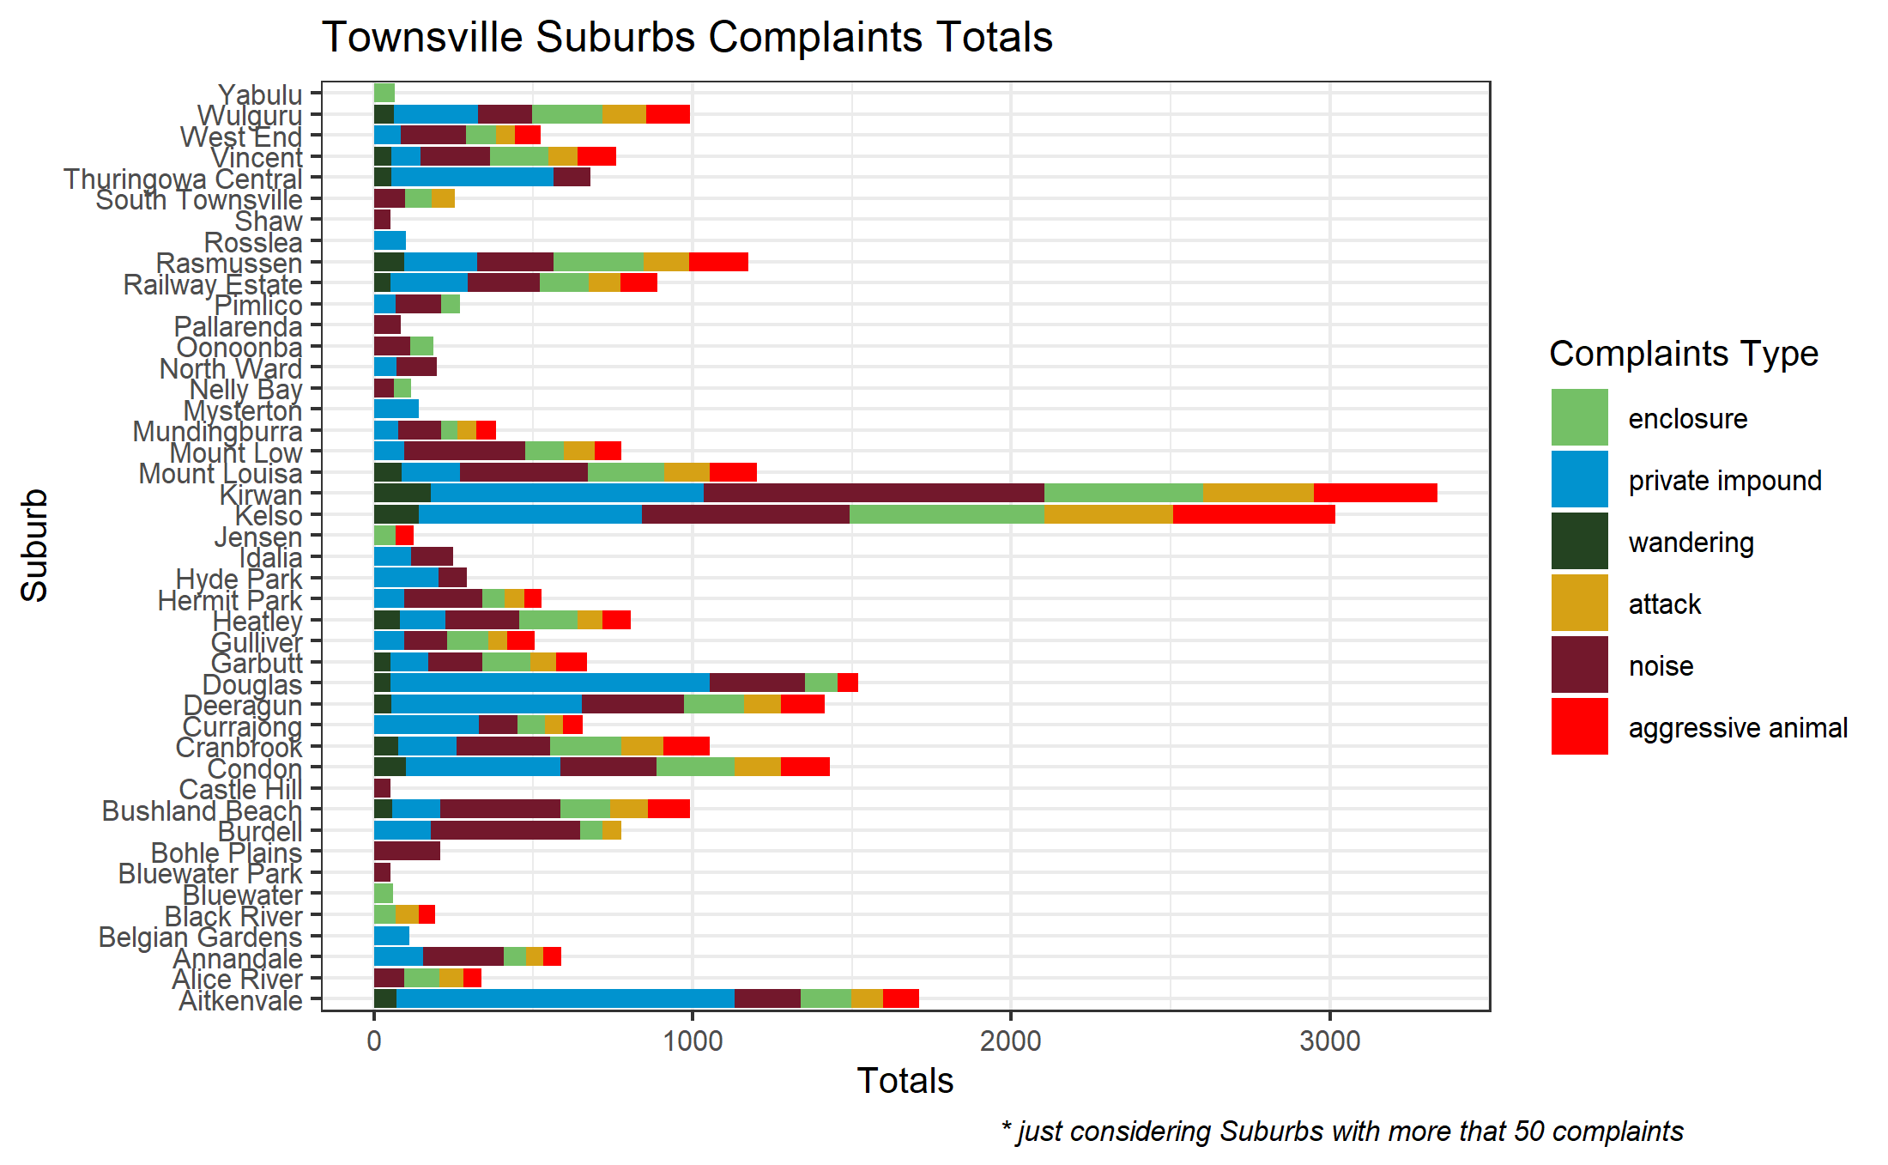
Notes:
For dogs there’s rainbow of variety in the complaint type. Noise seems to be the most common type, followed by private impound.
Mount Louisa and Kirwan have a very high volume of calls for aggressive dogs and even attacks. There is a high level of call for enclosure as well, which could be either a trapped animal or most probably in this case a dog tied to a chain outside in hot water or closed inside without the opportunity to go out, this again reflects in the high than average amount of calls for noise.
RSPCA should probably led a further enquire on pets welfare in this suburbs and concentrate a campaign on how to be a good dog owner.
-GO BACK A SLIDE, KIRWAN HAS HIGH CALLS VOLUME FOR CATS AS WELL.

Slide 28


• What is the total call volume for complaint calls regarding pets in Brisbane and Townsville?
2,070
4,094
13,333
38,3719

Slide 29
• Is there a particular animal being called about the most?
Notes:
Because probably they are the most popular pet?

Slide 30
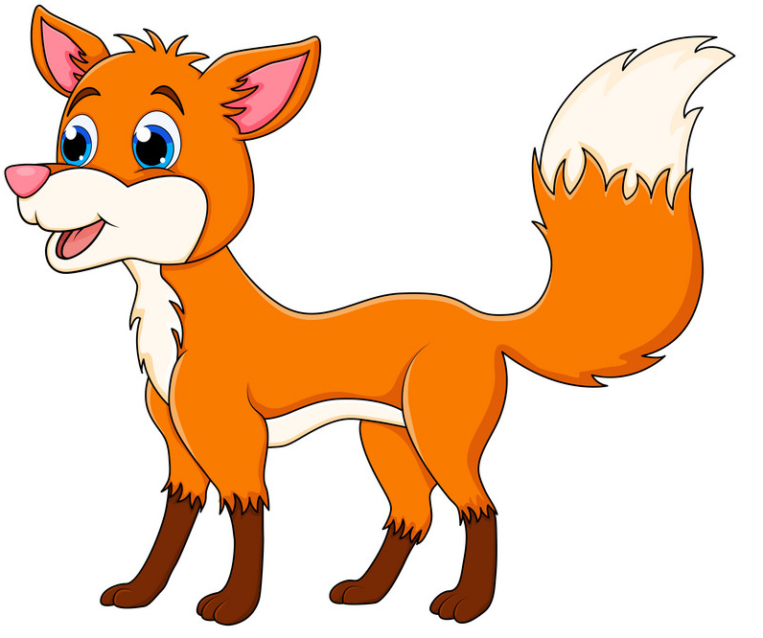
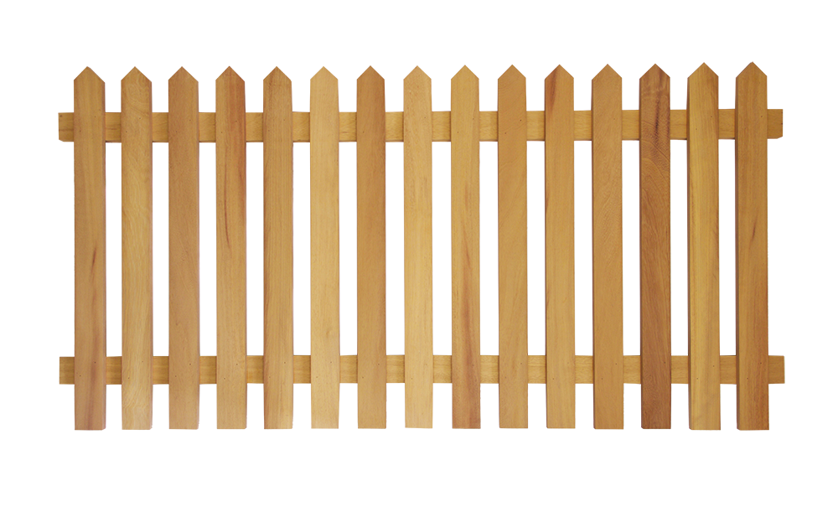
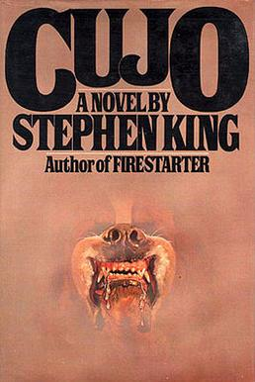
• Do particular suburbs have different type of complaint calls?
Inala
Mount Louisa
Kirwan
Notes:
Because probably they are the most popular pet?

Slide 31
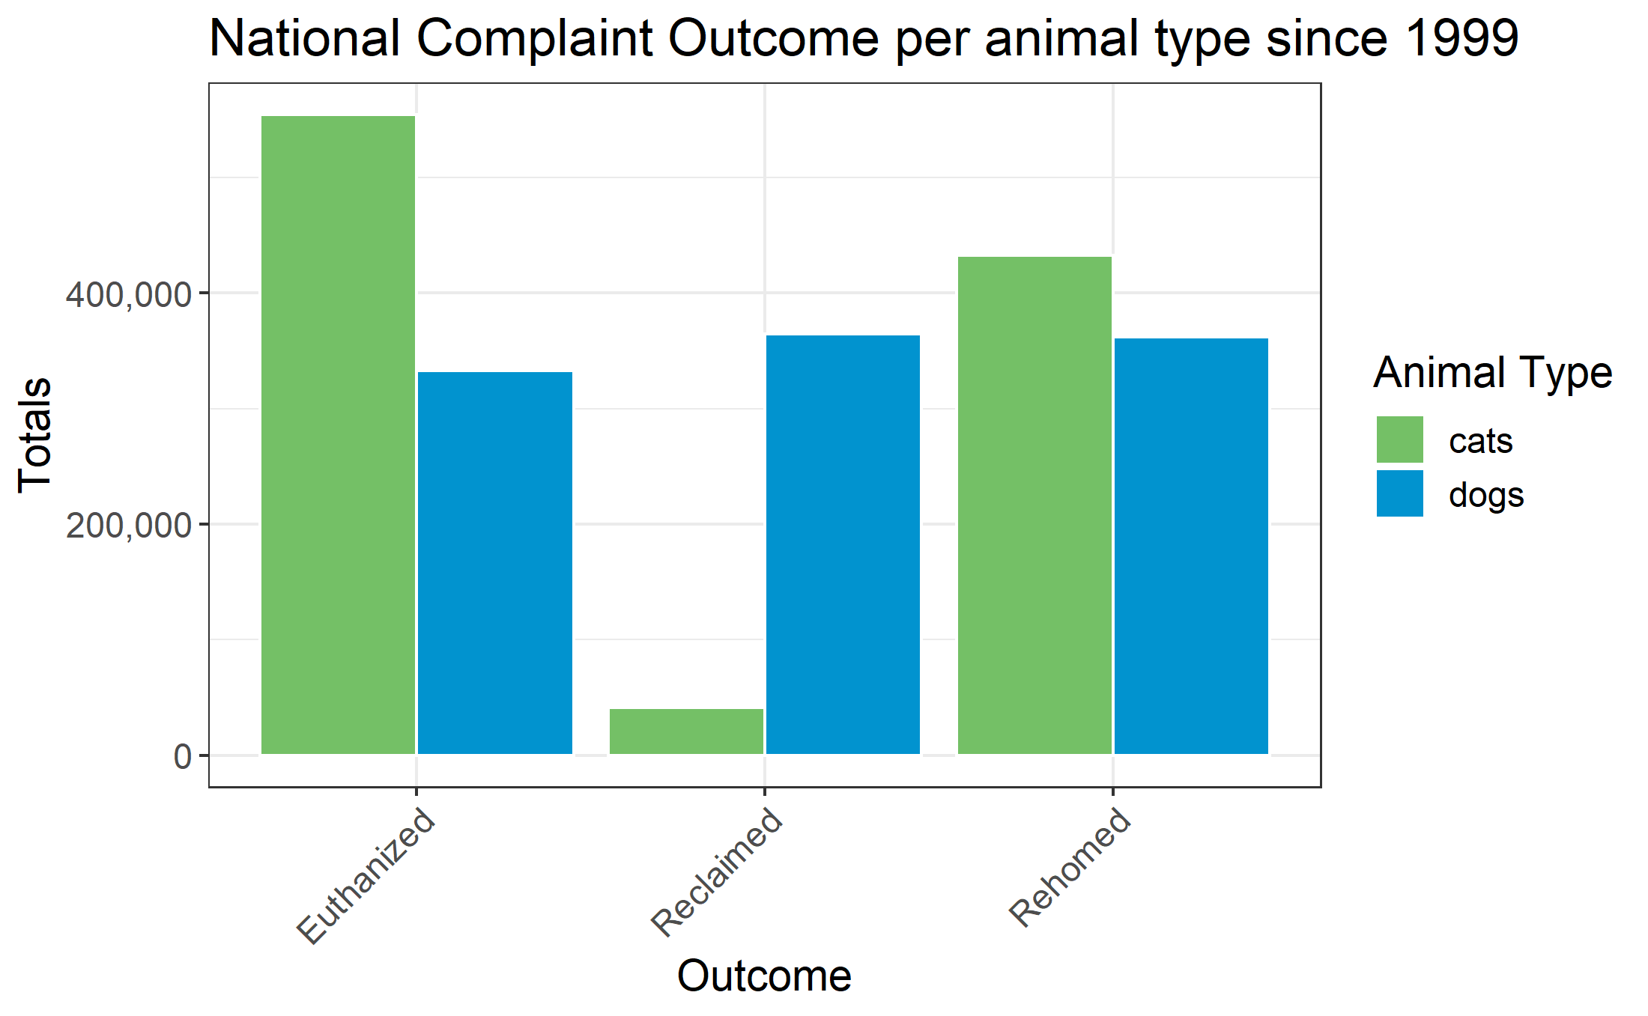
• How have the different outcomes trended over time? Did RSPCA work have an impact?
Notes:
The outcome for complaint when the animal is taken in custody by RSPCA from 1999.
The most common outcome for cats is to be euthanised, and they are not reclaimed as often a dogs and I am not sure how many how the rehoming are successful, I can imagine that a cat that gets returned to RSPCA or ends up again in the street is not a rare scenario, that would explain the difference in numbers for euthanised and reclaimed with dogs.
The number of cats and dogs in the data set is almost equivalent so I tend to believe the above hypothesis.
Cats 1117506
Dogs 1149320

Slide 32
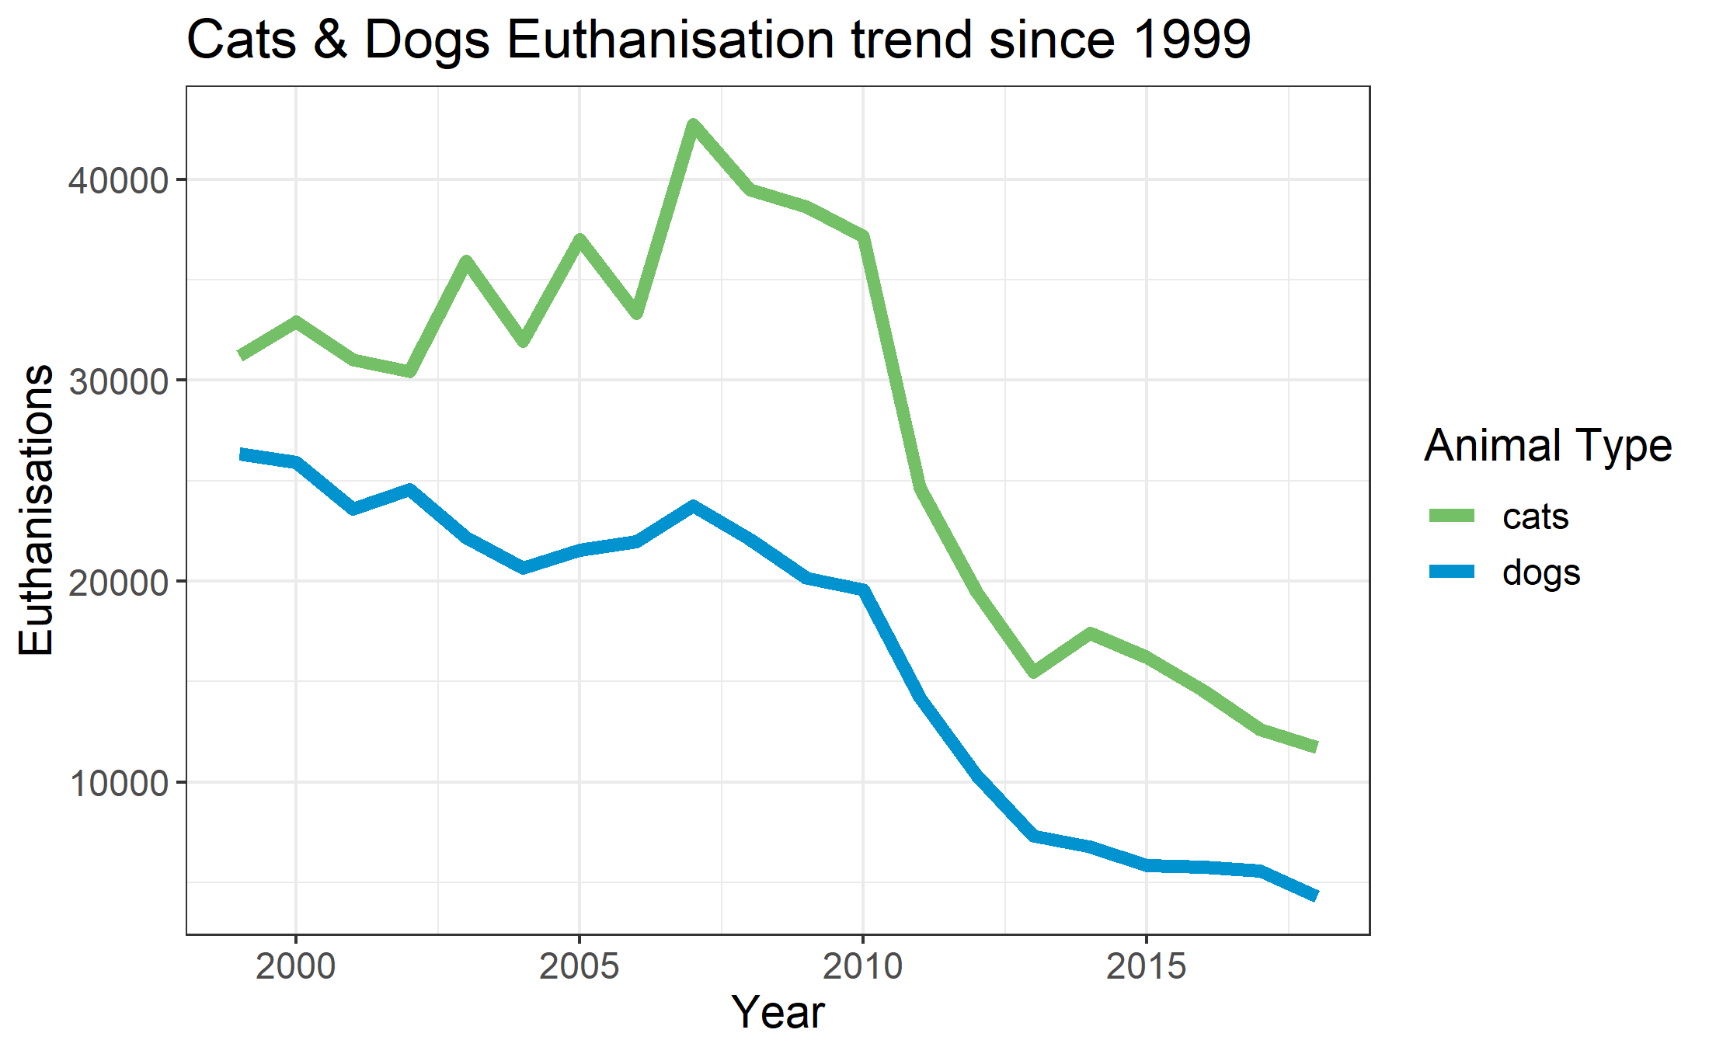
• How have the different outcomes trended over time? Did RSPCA work have an impact?
Notes:
The good news is that the trend is changing, since the 2010s euthanisations have dropped drastically.

Slide 33
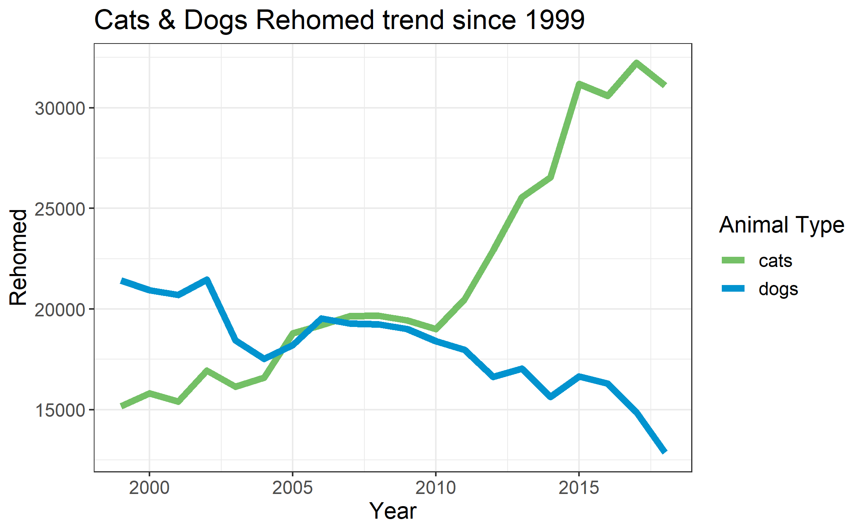
• How have the different outcomes trended over time? Did RSPCA work have an impact?
Notes:
Rehoming numbers for cats have increase drastically since the 2010s, but again I have doubts on how many of these were successful.

Slide 34
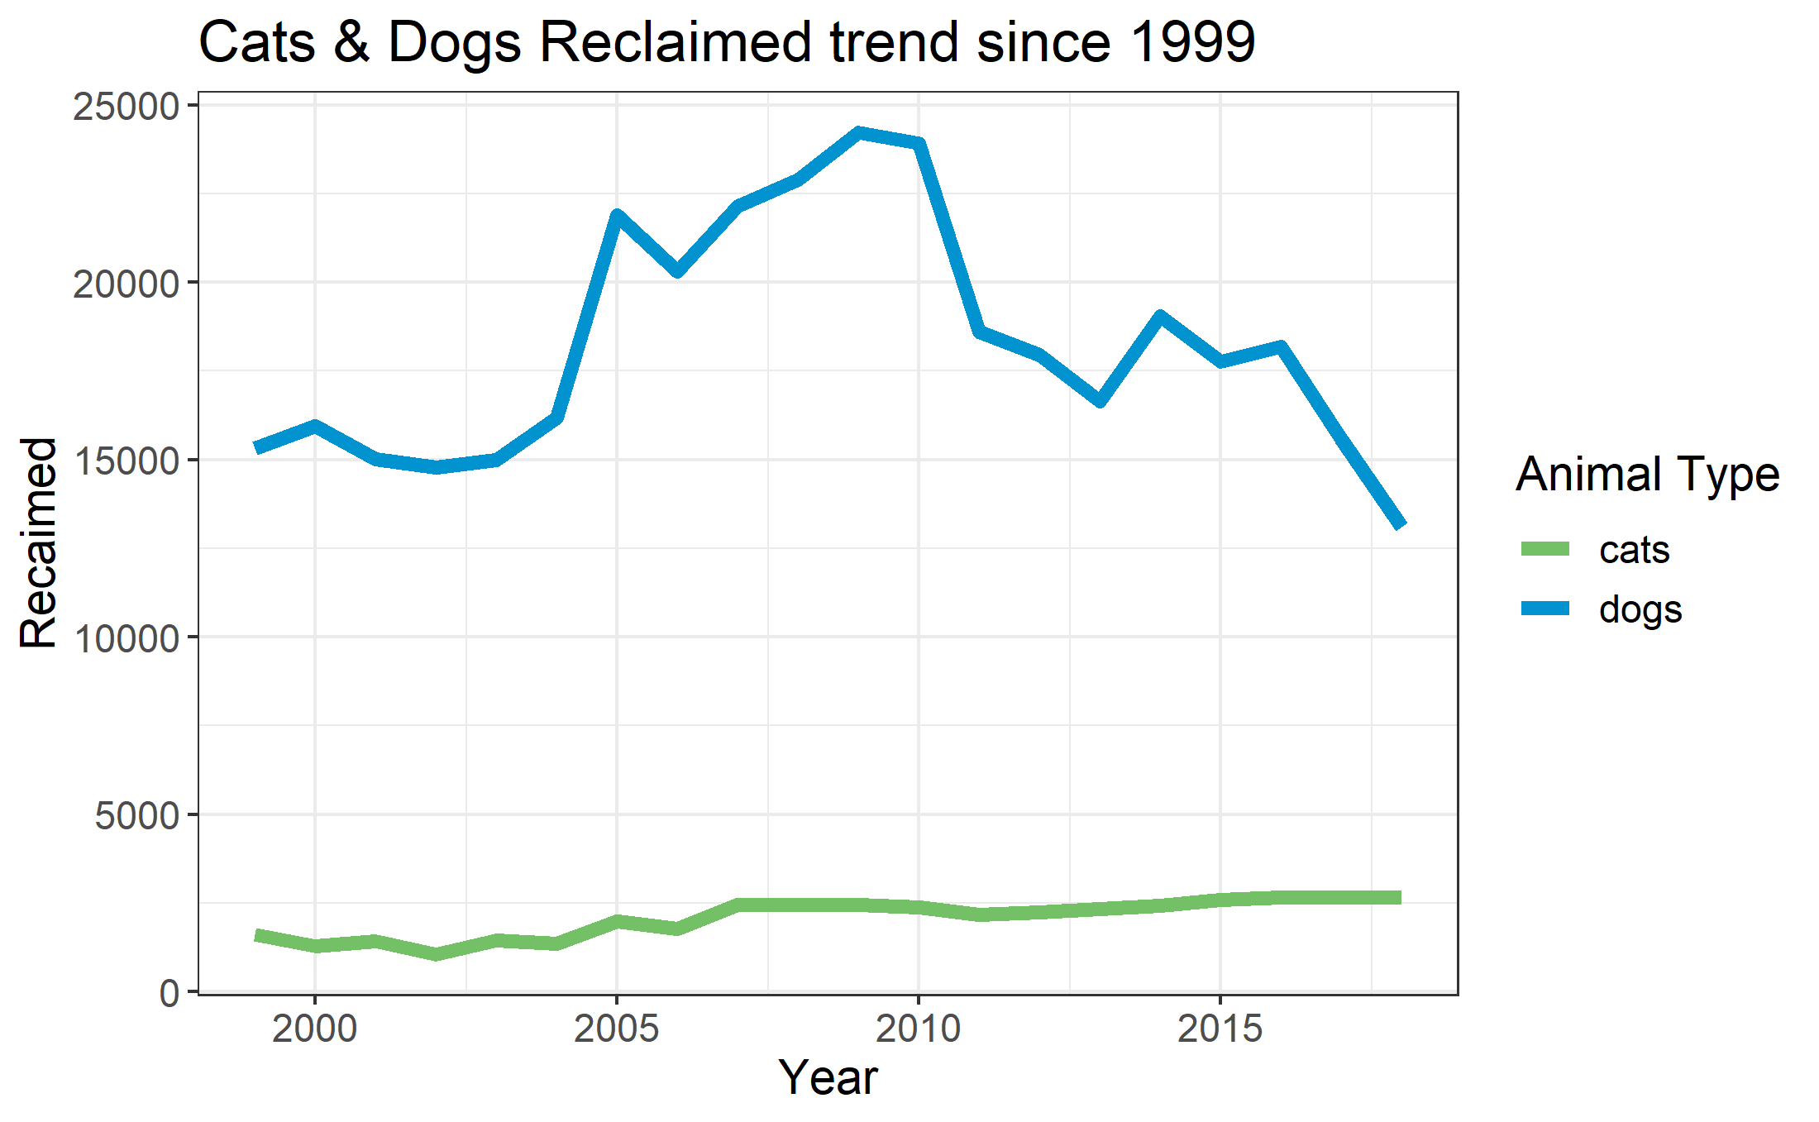
• How have the different outcomes trended over time? Did RSPCA work have an impact?
Notes:
The reclaimed trends for cats hasn't been that great and it's stable during the years.
For dog the trend is going down although this couldn't been so gloom, with the diffusion of social media and in particular neighbourhood pages, when a dog go missing the voice is spread quickly and usualy they are found before RSPCA intervention.

Slide 35
• Using the insights found, can we predict how this might look for the upcoming year?
An animal taken in RSPCA’s care
has the 47% chance to be euthanised
44% chance
euthanised
52% chance
rehomed
In Western Australia and
Australia Capital territory
an animal taken in RSPCA’s
care has the 69% chance of
being rehomed
New South Wales, Northern Territory, Queensland, South Australia, Tasmania and Victoria cats have a 43% chance to be euthanised, while dogs have a 51%
Chance to be rehomed
If the change of trend in euthanisation
and rehoming started in 2012 continues,
RSPCA could rehome the 67% of animals
in their care in the next years

Slide 36
Data Source:
• The Open RSPCA database
• Townsville Animal Complaints
• Brisbane Open Data - Animal Complaints

